Slide 1
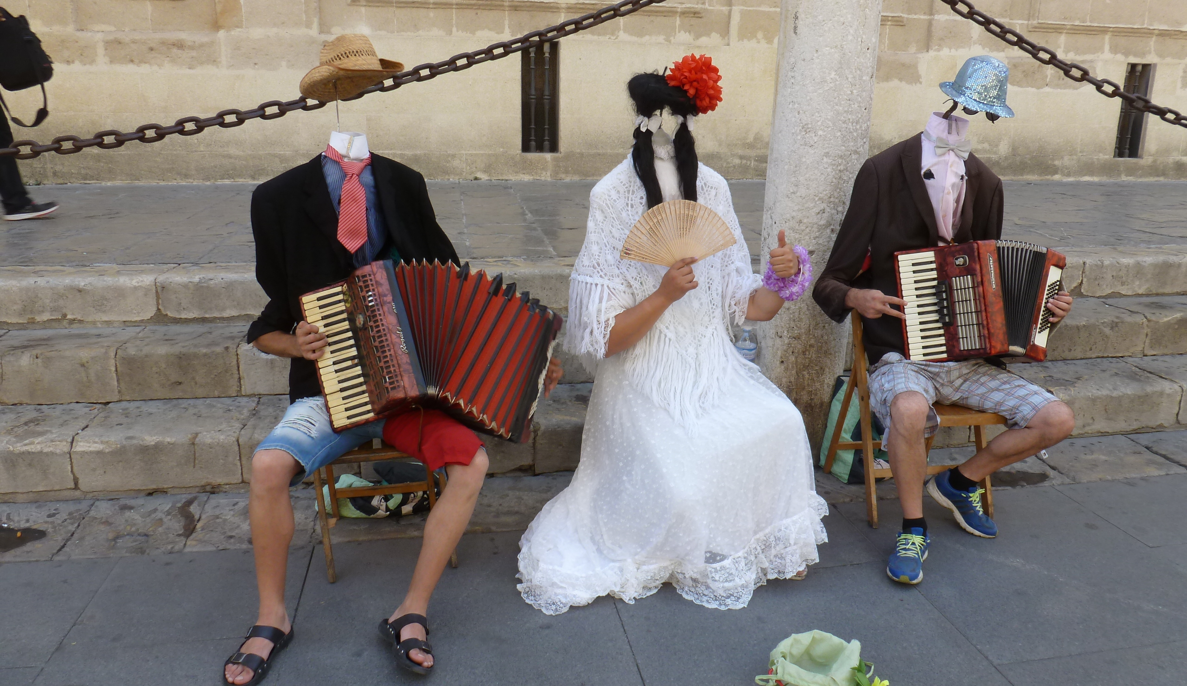
HTML / CSS 5
Responsive design en formulieren

Slide 2
Inhoud - HTML/CSS 5
Responsive design met mediaqueries
Formulieren
Formulierelementen
Input types
Input attributen
Handleiding: internetingishard.com
Videotutorials: www.codeschool.com/courses/front-end-foundations
Naslag en probeersels: www.w3schools.com
Notes:
Deze samenvatting baseert op
Interneting Is Hard (https://internetingishard.com/html-and-css/)
de hoofdstukken Responsive Design en Forms
Ter ondersteuning de Codeschool video's
FRONT-END FOUNDATIONS (https://www.codeschool.com/courses/front-end-foundations/videos)
Level 5: Creating Webforms
Front-End Formations (https://www.codeschool.com/courses/front-end-formations/videos)
Level 3: HTML5 Forms

Slide 3
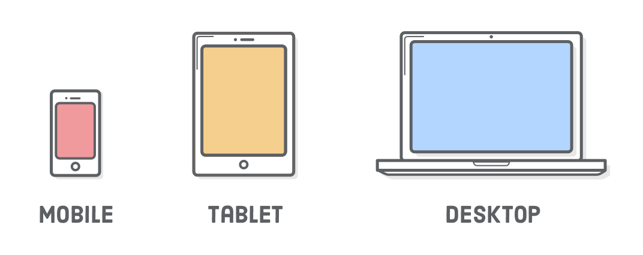
Responsive - mediaqueries - viewport
@media only screen and (max-width: 400px) { /* mobiles */ body { background-color: red; } } @media only screen and (min-width: 401px) and (max-width: 960px) { body { background-color: yellow; } /* tablets */ } @media only screen and (min-width: 961px) { /* desktops */ body { background-color: blue; } }
<meta name='viewport' content= 'width=device-width, initial-scale=1.0, maximum-scale=1.0' />
Mediaquery - viewport - breakpoint

Slide 4
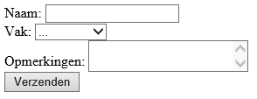
Formulier
<form method="get" action=""> <label for="naam">Naam: </label> <input type="text" name="naam" id="naam"><br> <label for="naam">Vak: </label> <select name="vak" id="vak"> <option value="">...</option> <option value="saq">SAQ</option> <option value="spd">SPD</option> <option value="db">Database</option> <option value="wt">WebTech</option> </select><br> <label for="opmerking">Opmerkingen: </label> <textarea name="opmerking" id="opmerking"></textarea><br> <input type="submit" name="verzenden" value="Verzenden"> </form>
Method - action - tekstveld - keuzelijst - textarea - verzendknop - optie - waarde
form label input select textarea for="" type="" name="" id=""

Slide 5
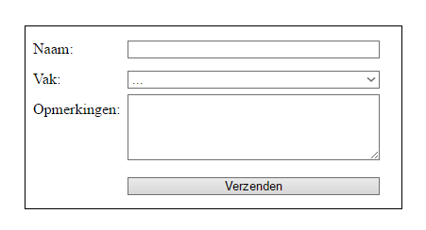
Formulier met simpele opmaak
* { margin: 0; padding: 0; box-sizing: border-box; }
form { line-height: 2; margin: 2em auto; padding: 0.5em; border: 1px black solid; width: 400px; } label { width: 25%; display: inline-block; vertical-align: top; } input, select, textarea { width: 70%; } textarea { height: 70px; } input[type=submit]{ margin-left: 25%; }
reset - attribuut selector
line-height: vertical-align: inline-block input[type=submit]

Slide 6
Formulierelementen
<form method="get" action="bestel.php" class="subway">
<h2>Bestel maar</h2> <label for="sub">Sub </label>
<select name="sub" id="sub"> <option value="1">Pulled Chicken</option> <option value="2">Spicey Italian</option> <option value="3">Subway Melt</option> <option value="4" selected>B.L.T & Avocado</option> <option value="5">Veggie Patty</option> </select><br> <label>Brood</label> <input type="radio" name="brood" value="a" checked> Bruin <input type="radio" name="brood" value="b"> Wit <input type="radio" name="brood" value="b"> Sesam <br> <fieldset> <legend>Toppings</legend> <input type="checkbox" name="topping1" value="Paprika"> Paprika <input type="checkbox" name="topping2" value="Olijven"> Olijven <input type="checkbox" name="topping3" value="Uien"> Uien <input type="checkbox" name="topping4" value="Mayonaise"> Mayonaise <input type="checkbox" name="topping5" value="Mosterd"> Mosterd </fieldset> <input type="submit" name="bestellen" value="Bestellen">
<input type="reset" value="Annuleren"> </form>
input type="tekst|password|radio|checkbox|submit|reset"
value="" checked selected multiple placeholder required

Slide 7
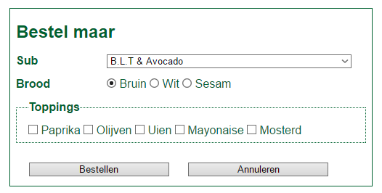
En hier het resultaat
.subway { color: #006230; width: 500px;
font-family: "Helvetica", "Arial", sans-serif;} .subway label, .subway legend { font-weight:bold; } .subway input[type=submit], .subway input[type=reset] {
width: 40%; margin: 2em 1em 0 1em; }
fieldset { padding: 0 1em; border: #006230 dotted 1px; }
input[type=radio], input[type=checkbox] { width: auto; }

